Slide 1
Linear Data Structure Queue
Data Structures (DS)
GTU # 3130702

Slide 2
Queue
A linear list which permits deletion to be performed at one end of the list and insertion at the other end is called queue.
The information in such a list is processed FIFO (first in first out) or FCFS (first come first served) manner.
Front is the end of queue from that deletion is to be performed.
Rear is the end of queue at which new element is to be inserted.
Insertion operation is called Enqueue & deletion operation is called Dequeue.
10
8
5
80
50
100
Deletion
Insertion
Front
Rear

Slide 3
Applications of Queue
Queue of people at any service point such as ticketing etc.
Queue of air planes waiting for landing instructions.
Queue of processes in OS.
Queue is also used by Operating systems for Job Scheduling.
When a resource is shared among multiple consumers. E.g., in case of printers the first one to be entered is the first to be processed.
When data is transferred asynchronously (data not necessarily received at same rate as sent) between two processes. Examples include IO Buffers, pipes, file IO, etc.
Queue is used in BFS (Breadth First Search) algorithm. It helps in traversing a tree or graph.
Queue is used in networking to handle congestion.

Slide 4
Procedure: Enqueue (Q, F, R, N,Y)
*Assuming indexing starts from 1
This procedure inserts Y at rear end of Queue.
Queue is represented by a vector Q containing N elements.
F is pointer to the front element of a queue.
R is pointer to the rear element of a queue.
R
5
20
80
F
1. [Check for Queue Overflow]
If R >= N
Then write (‘Queue Overflow’)
Return
2. [Increment REAR pointer]
R ← R + 1
3. [Insert element]
Q[R] ← Y
4. [Is front pointer properly set?]
IF F=0
Then F ← 1
Return
N=3, R=0, F=0
F =
0
1
2
1
3
R =
0
Enqueue (Q, F, R, N=3,Y=5)
Enqueue (Q, F, R, N=3,Y=20)
Enqueue (Q, F, R, N=3,Y=80)
Enqueue (Q, F, R, N=3,Y=3)
Queue Overflow

Slide 5
Function: Dequeue (Q, F, R)
This function deletes & returns an element from front end of the Queue.
Queue is represented by a vector Q containing N elements.
F is pointer to the front element of a queue.
R is pointer to the rear element of a queue.
Case No 1:
F=0, R=0
[Check for Queue Underflow]
If F = 0
Then write (‘Queue Underflow’)
Return(0)
2. [Delete element]
Y ← Q[F]
3. [Is Queue Empty?]
If F = R
Then F ← R ← 0 Else F ← F + 1
4. [Return Element]
Return (Y)
Queue Underflow
Case No 2:
F=3, R=3
F
R
F=0, R=0
50
Case No 3:
F=1, R=3
F
R
5
-8
50
F=2, R=3

Slide 6
Example of Queue Insert / Delete
Perform following operations on queue with size 4 & draw queue after each operation
Insert ‘A’ | Insert ‘B’ | Insert ‘C’ | Delete ‘A’ | Delete ‘B’ | Insert ‘D’ | Insert ‘E’
Empty Queue
R=3
F=1
Insert ‘C’
R=4
F=3
Insert ‘D’
0
0
A
B
C
C
D
F
R
F
R
F
R
R=1
Insert ‘A’
R=3
F=2
Delete ‘A’
R=4
F=3
Insert ‘E’
F=1
A
A
B
C
C
D
F
R
F
R
F
R
Insert ‘B’
R=3
F=3
Delete ‘B’
(R=4) >= (N=4) (Size of Queue)
R=2
F=1
Queue Overflow
A
B
B
C
Queue Overflow, but space is there with Queue, this leads to the memory wastage
F
R
F
R

Slide 7
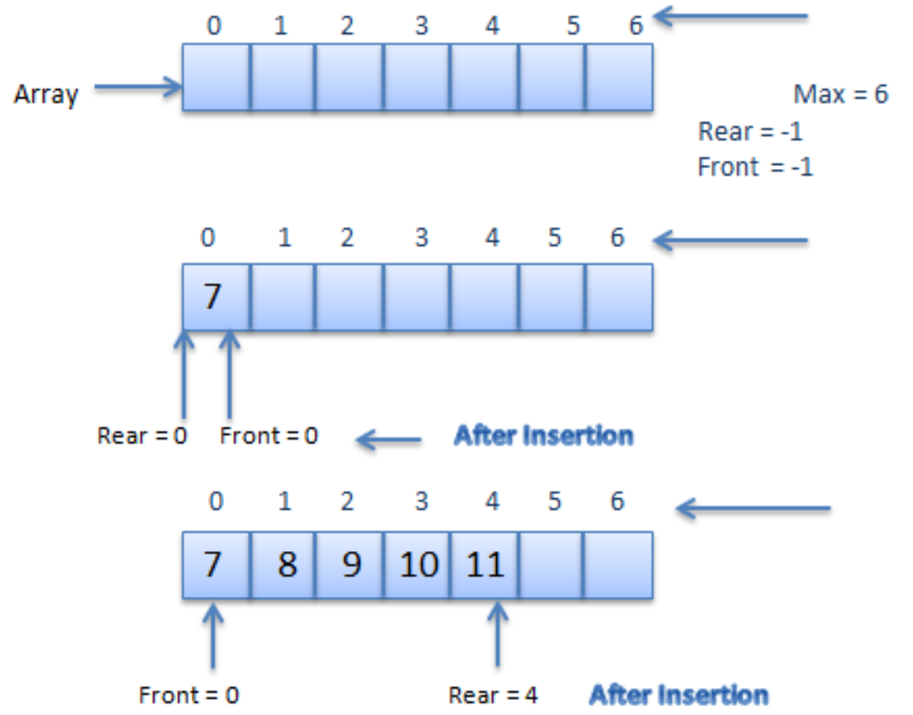
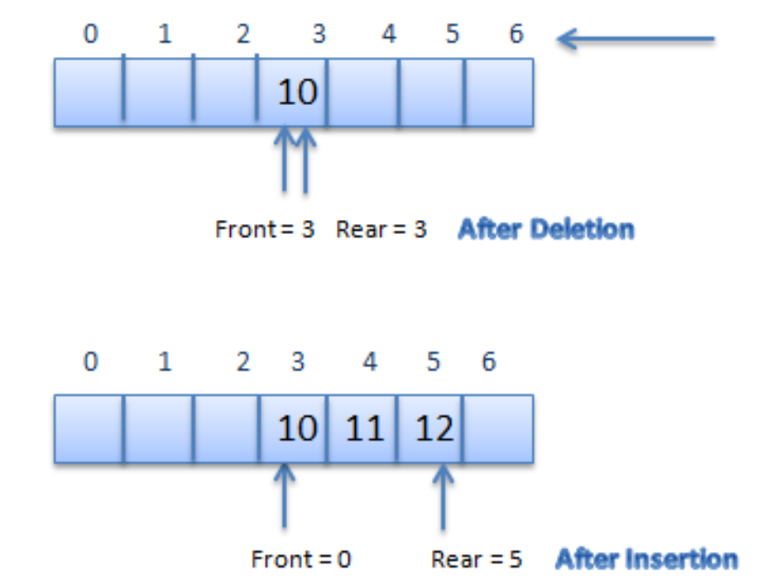
In C programming where index starts from 0

Slide 8
Performance and Limitations
Performance
Let n be the number of elements in the queue
The space used is O(n)
Each operation runs in time O(1)
Limitations
The maximum size of the queue must be defined apriori and cannot be changed
Trying to enqueue an element into a full queue causes an implementation-specific exception

Slide 9
Queue with a Singly Linked List
We can implement a queue with a singly linked list
The front element is stored at the head of the list
The rear element is stored at the tail of the list
The space used is O(n) and each operation of the Queue ADT takes O(1) time
rear
nodes
f
front
∅
elements

Slide 10
Queue: Linklist
front = NULL, rear = NULL;
void enqueue(int data)
{
struct Node* new_node = newNode(data);
if (front==NULL and rear==NULL)
{
front = rear = new_node;
}
else
{
rear->next = new_node;
rear = rear->next;
}
}
void dequeue()
{
if (front==NULL and rear==NULL)
{
printf(“Underflow”);
}
else
{
temp = front;
front = front->next;
if (front == NULL)
rear = NULL;
free(temp);
}
}
void display()
{
for(temp=front; temp!=NULL; temp=temp->next)
printf("%d ", temp->value);
}

Slide 11
Queue Summary
 | Array Fixed-Size | Array Expandable (doubling strategy) | List Singly-Linked
dequeue() | O(1) | O(1) | O(1)
enqueue(o) | O(1) | O(n) Worst Case O(1) Best Case O(1) Average Case | O(1)
front() | O(1) | O(1) | O(1)
Size(), isEmpty() | O(1) | O(1) | O(1)

Slide 12
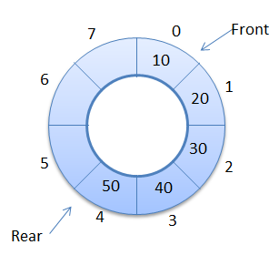
Circular Queue
A more suitable method of representing simple queue which prevents an excessive use of memory is to arrange the elements Q[1], Q[2]….,Q[n] in a circular fashion with Q[1] following Q[n], this is called circular queue.
In circular queue the last node is connected back to the first node to make a circle.
Circular queue is a linear data structure. It follows FIFO principle.
It is also called as “Ring buffer”.
Q[1]
Q[2]
Q[n]

Slide 13
Procedure: CQINSERT (F, R, Q, N, Y)
This procedure inserts Y at rear end of the Circular Queue.
Queue is represented by a vector Q containing N elements.
F is pointer to the front element of a queue.
R is pointer to the rear element of a queue.
F
R
8
15
F
R
1. [Overflow]
If F=(R+1)% N
Then Write(‘Overflow’)
Return
2. [Insert element]
R ← R+1
Q[R] ← Y
3. [Is front pointer properly set?]
IF F=0
Then F ← 1
Return
8
15
F
R
23
6
8
15

Slide 14
Function: CQDELETE (F, R, Q, N)
This function deletes & returns an element from front end of the Circular Queue.
Queue is represented by a vector Q containing N elements.
F is pointer to the front element of a queue.
R is pointer to the rear element of a queue.
F
R
6
R
F
1. [Underflow?]
If F = 0
Then Write(‘Underflow’)
Return(0)
2. [Delete Element]
Y ← Q[F]
If F = R
F ← R ← 0
Else
F ← (F+1)%N
Return (Y)
2
6
4
F
R
6
8
4

Slide 15
Example of CQueue Insert / Delete
Perform following operations on Circular queue with size 4 & draw queue after each operation
Insert ‘A’ | Insert ‘B’ | Insert ‘C’ | Delete ‘A’ | Delete ‘B’ | Insert ‘D’ | Insert ‘E’
Empty Queue
R=3
F=1
Insert ‘C’
R=4
F=3
Insert ‘D’
0
0
A
B
C
C
D
F
R
F
R
F
R
R=1
Insert ‘A’
R=3
F=2
Delete ‘A’
R=1
F=3
Insert ‘E’
F=1
A
A
B
C
E
C
D
F
R
F
R
F
R
Insert ‘B’
R=3
F=3
Delete ‘B’
R=2
F=1
A
B
B
C
F
R
F
R

Slide 16
The Double-Ended Queue
Double Ended Queue is a type of queue in which insertion and removal of elements can either be performed from the front or the rear. Thus, it does not follow FIFO rule (First In First Out).
Types of Deque
Input Restricted Deque: In this deque, input is restricted at a single end but allows deletion at both the ends.
Output Restricted Deque: In this deque, output is restricted at a single end but allows insertion at both the ends.

Slide 17
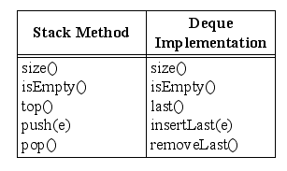
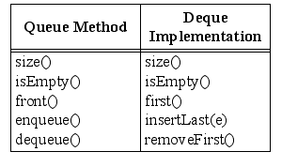
Implementing Stacks and Queues with Deques
Stacks with Deques:
Queues with Deques:

Slide 18
Dequeue Summary
 | Array Fixed-Size | Array Expandable (doubling strategy) | List Singly-Linked | List Doubly-Linked
removeFirst(), removeLast() | O(1) | O(1) | O(1) | O(1)
insertFirst(o), InsertLast(o) | O(1) | O(n) Worst Case O(1) Best Case O(1) Average Case | O(1) | O(1)
first(), last() | O(1) | O(1) | O(1) | O(1)
Size(), isEmpty() | O(1) | O(1) | O(1) | O(1)

Slide 19
Priority Queue
A queue in which we are able to insert & remove items from any position based on some property (such as priority of the task to be processed) is often referred as priority queue.
Below fig. represent a priority queue of jobs waiting to use a computer.
Priorities are attached with each Job
Priority 1 indicates Real Time Job
Priority 2 indicates Online Job
Priority 3 indicates Batch Processing Job
Therefore if a job is initiated with priority i, it is inserted immediately at the end of list of other jobs with priorities i.
Here jobs are always removed from the front of queue.

Slide 20
Priority Queue Cont…
Task
R₁ | R₂ | … | R_{i-1} | O₁ | O₂ | … | O_{j-1} | B₁ | B₂ | … | B_{k-1} | …
1 | 1 | … | 1 | 2 | 2 | … | 2 | 3 | 3 | … | 3 | …
Priority
R_{i}
O_{j}
B_{k}
Priority Queue viewed as a single queue with insertion allowed at any position
Priority - 1
R₁ | R₂ | … | R_{i-1}
R_{i}
Priority - 2
O₁ | O₂ | … | O_{j-1}
O_{j}
Priority - 3
B₁ | B₂ | … | B_{k-1}
B_{k}
Priority Queue viewed as a Viewed as a set of queue

Slide 21
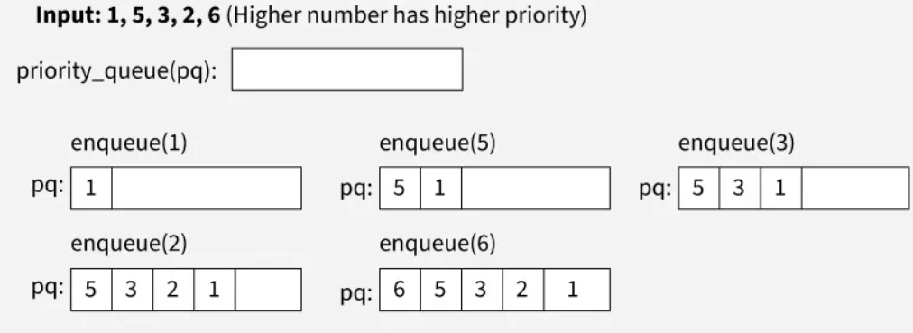
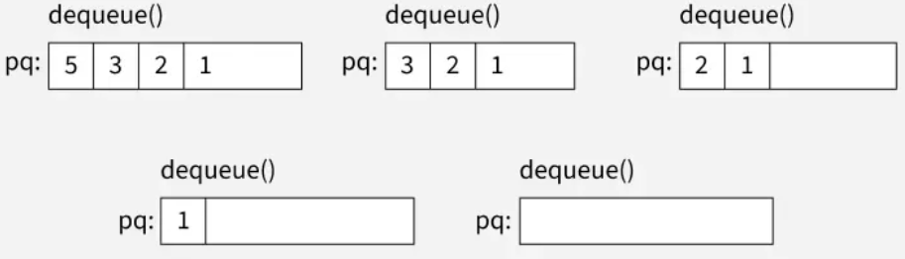

Slide 22
